Slide 1

Developing a Reusable Application Framework
  Aaron Mulder, Chariot Solutions

Slide 2

Today, we’ll discuss…
Why develop a framework? What does it do?
20 elements of a strong application framework
Including project infrastructure in the framework
Creating and maintaining a framework

Slide 3
About Aaron Mulder
Chief Technical Officer of Chariot Solutions
Published author (Professional EJB, BEA WebLogic 7.0 Application Server Deployment and Administration Handbook)
Presented at JavaOne 2001/2002, and the Philadelphia Java Users Group
Member of the JSR-88 Expert Group (J2EE Application Deployment)
Contributed to open-source projects such as JBoss, OpenEJB, and PostgreSQL

Slide 4
About Chariot Solutions
Information Technology provider focused on automating business processes
Team of leading Java architects on staff
Technical expertise in software architecture and development, and systems integration
Proven track record with companies such as ExxonMobil, Midas, Rosenbluth International, UGI Utilities, and the State of New Jersey

Slide 5
Introduction to Frameworks

Slide 6
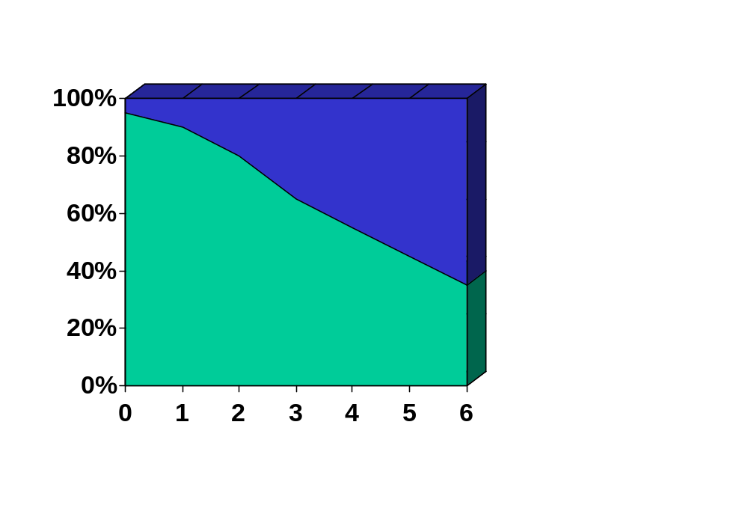
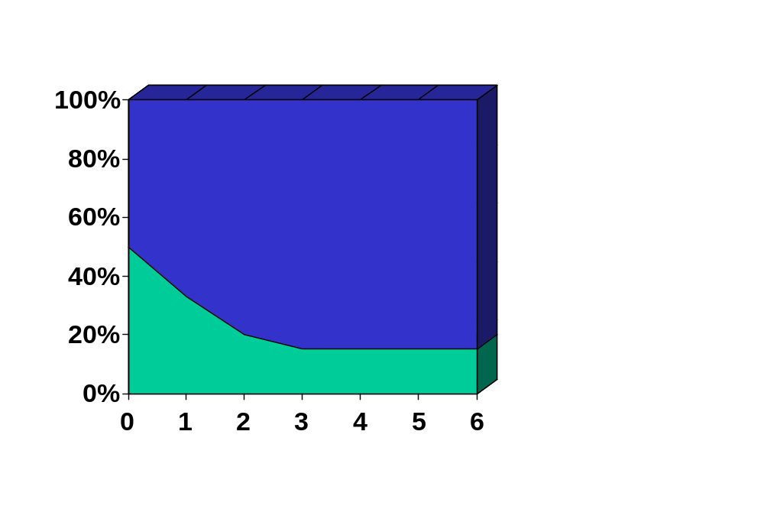
Why Use a Framework?
Starting from scratch
Using a framework
Application Development
Application Development
Infrastructure Development
Infrastructure Dev.
MONTHS
MONTHS
Notes:
Without some sort of application framework in place, every project begins from scratch and needs to spend months ramping up to development. Much of that time is spent in long architecture meetings arguing over possible directions. Other important decisions end up being made by low-level developers because they were overlooked in initial discussions. Documents and code from the first few months become a black hole where no developer wants to venture.

Slide 7
Why Use a Framework, cont.
Time Savings
  Common functionality
  Canned designs / modular architecture
  Advanced features without time constraints
  Make development easier
Quality
  Eliminate repetitive bugs across projects
  Eliminate duplicate / “copy & paste” implementations
  Canned test scripts
  Single interface for all clients
Prepare for audits, etc.
Notes:
Without some sort of application framework in place, every project begins from scratch and needs to spend months ramping up to development. Much of that time is spent in long architecture meetings arguing over possible directions. Other important decisions end up being made by low-level developers because they were overlooked in initial discussions. Documents and code from the first few months become a black hole where no developer wants to venture.

Slide 8
What’s in a Framework?
Knowledge base
Product reviews, configuration information, lessons learned
Document templates
Requirements, Use Cases, Design Specs, Test Plans, etc.
Design patterns, standards
Coding & naming standards, proven design strategies, etc.
Code libraries
Base classes, format utilities, tag libraries, etc.
Code templates and generators
Automated generation of starting code, based on templates
Notes:
A strong application framework is more than just code. If another development team has just evaluated a product you’re considering, you should have access to their review to help make your decision. If they tried a design pattern and found it lacking, that experience should be shared. From product reviews to tutorials to project post-mortems, everything should be saved and indexed in a company-wide knowledgebase. Furthermore, the framework should be a living entity. When new designs are found to be more effective, they should be added to the repository. The end result is a launching pad for any new product, giving architects a treasure trove of time-saving knowledge, documentation and code with which to begin.

Slide 9
Application Design Issues

Slide 10
Common Framework Elements
The 20 application design issues which follow were chosen because they are:
Common to many applications
Reusable across most projects
Solvable in more than one way
There are more questions than answers. Every team's needs are different, and every framework will be different.

Slide 11
Persistence
1
Finding the right blend of performance and automation…
Avoid using all hand-coded SQL
Do we develop a custom persistence layer?
Can we use CMP for EJBs?
JDO is a general-purpose option, but which implementation?
Will likely need to address specific hot spots in any case

Slide 12
Unique Key Generation
2
Generating a unique primary key quickly and portably…
Various DBMS-specific features (sequences, auto-increment columns, etc.)
Table of “Varchar tableName, Integer maxID”
Grab a chunk of IDs at a time
Universal identifier, composed of IP address, timestamp, process ID, random #, etc.
Abstract away the details with a stateless session bean

Slide 13
Direct Database Access
3
Isolating and managing manually coded database access…
For those cases where the persistence framework falls short (searches, etc.)
Begin with some JDBC helper utilities
Could use query metadata and engine, but which is worse to maintain?
Probably want to separate data access classes

Slide 14
Resource Lookups
4
Naming and locating resources easily and portably…
Use component-local JNDI; declare resources in DDs (java:comp/env/...)
Use JNDI naming conventions (ejb/..., jdbc/...)
Populate JNDI with useful objects at startup
Use standard utilities to create InitialContext, look up EJB/DataSource/Mail Session, etc.

Slide 15
Data Transfer Objects
5
Improving performance with fewer network calls…
Strike a balance between parameter complexity and network traffic
Value objects (e.g. vs HashMaps)
Convenient hooks for versioning, validation...
Can auto-generate objects for entity beans, but how do we model relationships?
How do we add extra info (names for IDs)?

Slide 16
Concurrency
6
Handling simultaneous access to writable data…
EJB handles instantaneous concurrency, but what about “load screen, take coffee break”?
Add a version number to every entity table in the DB, check version in EJB updates?
How is the user informed?
Are some problems better solved by locking a record while it's in use? Status & owner cols?

Slide 17
Logging
7
Balancing performance and online debugging power…
Use a good logging library (Log4j, J2SE 1.4)
Pick log levels (trace, debug, info, warning...)
Standandardize what log messages are OK to leave in final code
Will distributed logging (i.e. for a cluster) be a concern? Do we use timestamps, or a central logging facility? Thread IDs?

Slide 18
Auditing
8
Keeping a trail of every attempted transaction…
Add an exact copy of every entity table in the DB, with added user and date fields
Add table (table/col names, old/new value)
Add last-updated-user/date fields
Do transactions fail if audit write fails?
How much data is kept “online”?
Will changes need to be “undone”?

Slide 19
Transactions
9
Atomicity, Consistency, Isolation, Durability…
Are container-managed transactions sufficient?
Will we ever need UserTransactions (TX spanning multiple back-end calls)
When should transactions be rolled back?
What is an appropriate transaction timeout? Should this / can this be set bean by bean?

Slide 20
Error Handling
10
Minimizing errors and recovering gracefully…
Handle user-caused exceptions
Handle system exceptions
Need to unwrap some exceptions (typically remote)
Should custom exceptions be RuntimeExceptions or checked exceptions?

Slide 21
User Messages
11
Displaying meaningful and helpful messages to the user…
Must use user-friendly language
Should use consistent terminology
Need to maintain context in nested calls
Can use tokenized error messages
Do we need to support internationalization?
Will we need to customize messages at runtime?

Slide 22
Formatting, Rounding Rules
12
Displaying dates, currencies and other formatted data…
May need to support multiple date formats, but beware unthreadsafe SimpleDateFormat
How many decimal places are appropriate?
What data must use BigDecimal (currency)?
What is the standard rounding mode?
Stuff all this in a helper class

Slide 23
Validation
13
Validating input in a user-friendly and yet secure way…
Don't want to repeatedly complain about individual fields
Don't want to hardcode length validations
Might need to validate in both the front end and the back end
Would be helpful to provide standard formatting validations

Slide 24
Security
14
Controlling access to protected methods and data…
How will users log in? Single-sign-on?
Should an application use a J2EE client container?
Will likely need a custom “realm” for every application server
How far can declarative security (deployment descriptors) take us?
Is there any row-level security?

Slide 25
User Management
15
Adding, editing and removing users at runtime…
Do we need to add/modify/remove users, groups, and permissions?
Will the application server notice updated values? If so, how often?
How will we update in a single-sign-on environment? Who has access?

Slide 26
Scheduling, Workflow
16
Handling extended or asynchronous conversations…
Scheduled jobs (data feeds, large reports)
What sort of periodic jobs do we expect?
Will notification of success/failure be required?
Is there going to be workflow? Are the rules all fixed, or can they be adjusted on the fly?
Do things expire?

Slide 27
Reporting, Printing
17
Presenting formatted data for offline viewing…
Do reports need to be viewed within the application (vs. launching separate viewer)?
What sorts of graphical bells and whistles will be required?
What are security constraints? Can reports be e-mailed?
How (long) are reports saved?
Can users customize & share templates?

Slide 28
System Setup / Installation
18
Starting from nothing…
Most applications need an initial configuration process
What data is present in initial data load, vs. loaded as part of application setup?
Will screens/reports need to change?
Will messages/terminology need to change?
Who will do the setup? Do we need a Wizard?

Slide 29
Import/Export
19
Getting data into and out of the system…
How “bulk” is bulk? SQL*Loader? XML?
Can all data be entered via EJBs, or must we use “Commit Option C”?
Do we need to load data based on external events (file receipt)?
What foreign-key relationships need to be managed?

Slide 30
Static Data
20
Organizing data that will “never” change…
How do we deal with states, statuses, other static data?
EJBs are kind of a waste, but is hardcoding OK? Some servers support read-only EJBs.
What if it does get updated?
What happens when business logic depends on specific values?

Slide 31
Development Infrastructure

Slide 32
Tools
How the team gets the job done…
IDE (many support a plugin architecture)
Build scripts (think Ant!), directory structure
Code generators
Source code control
Bug tracking
Time tracking
How much integration is appropriate?

Slide 33
Testing
Yes it's a very nice spec, but what did you actually code…?
Unit testing
Automated testing (load, regression, etc.)
Testing Issues:
  Login
  Data prep & cleanup
  Test dependencies
  Testing server components

Slide 34
Documentation
But my spec doesn't say that…
Team web site
Code standards & templates
Configuration information (tools, server, ...)
Use cases, models & specs
Test plans
Will documents be under source code control? (HTML, DocBook vs. MS Word)

Slide 35
Creating a Framework

Slide 36
Building a Framework
Use a pilot project
  Develop with framework in mind
  Extract framework at end of project
Build collaboratively across projects
  How do we synchronize framework(s)?
Use a dedicated framework team
  What order are issues addressed in?
  What happens to trial & error?

Slide 37
Maintaining a Framework
Do we use separate source code control for the framework?
Does every project get a source-level copy?
  How are changes propagated back?
Should a project expect updates? (Will the framework commit to backward compatibility?)
  Can we compartmentalize the framework?
What is the process for incompatible changes?
When is vendor dependence OK?

Slide 38
Distributing a Framework
Need to get buy-in from developers who are supposed to use the framework
Best to involve all groups in the planning
Implement some key time-saving features to make the benefits obvious
Document, document, document
  Overview of features, code documentation, tutorials, sample code, before & after, etc.
Define interfaces for everything
Eliminate dependencies where possible

Slide 39

Questions?

Slide 40
Download Slides:
http://www.chariotsolutions.com/presentations.html
Presentation Feedback:
http://www.chariotsolutions.com/feedback.html

